Slide 1
Graph Theory Basics
Thoughtful Engineering

Slide 2
Agenda
Recap
Why Study Graphs
Graph Rep – Adjacency List
DFS and BFS
Connected Components
Directed Graph

Slide 3
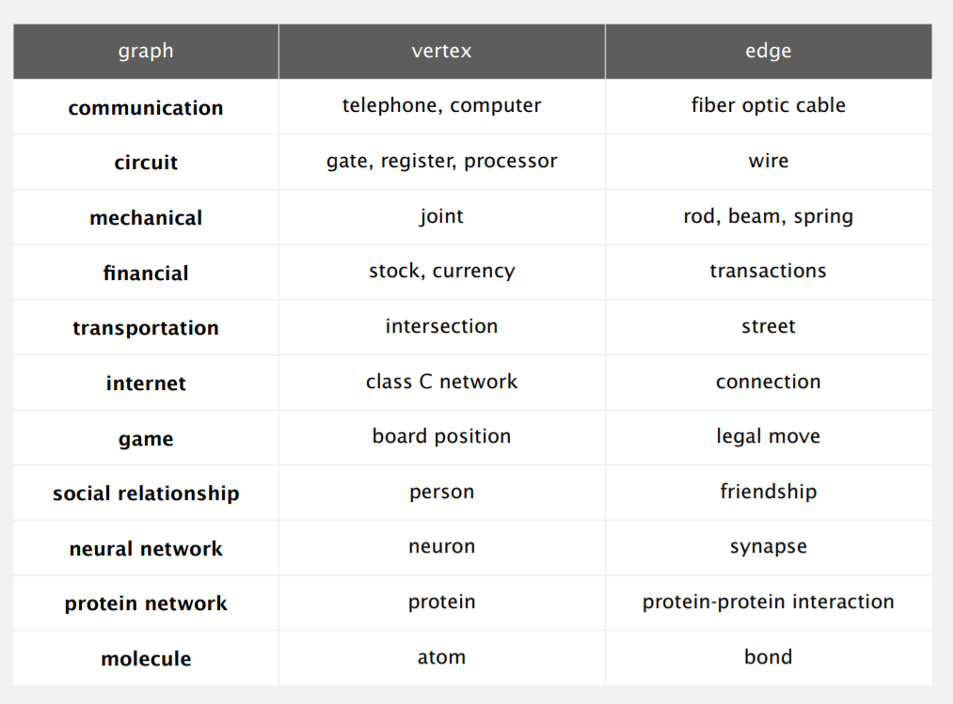
Recap

Slide 4
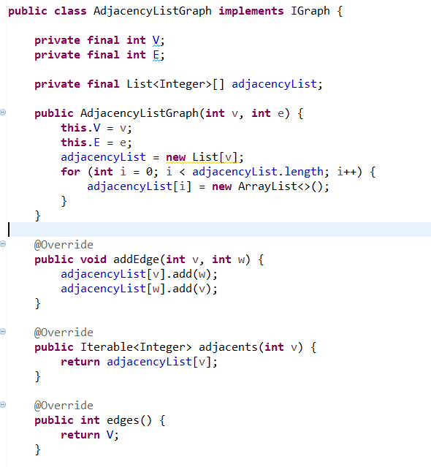
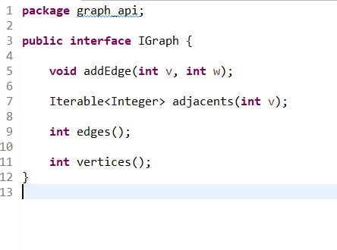
Recap – AdjList

Slide 5
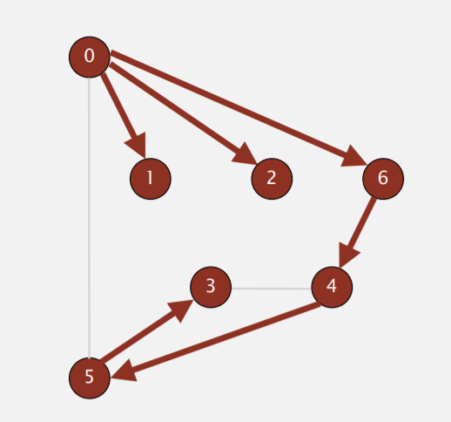
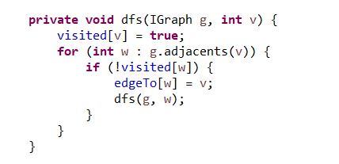
Recap - DFS
Use Recursion to traverse (helps in back track)
Marked current node as visited
Keep track of head node.
Typical Applications :
Find all vertices connected to a given source vertex.
Find a path between two vertices

Slide 6
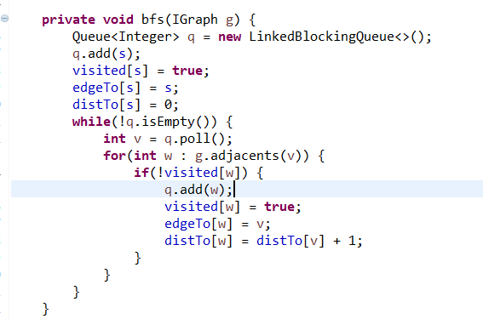
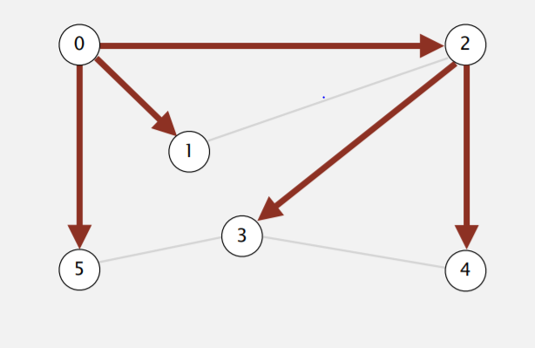
Recap - BFS
Use Queue.
Put v onto a FIFO queue, and mark it as visited.
Repeat until the queue is empty:
- remove the least recently added vertex v
- add each of v's unvisited neighbors to the queue, and mark them as visited

Slide 7
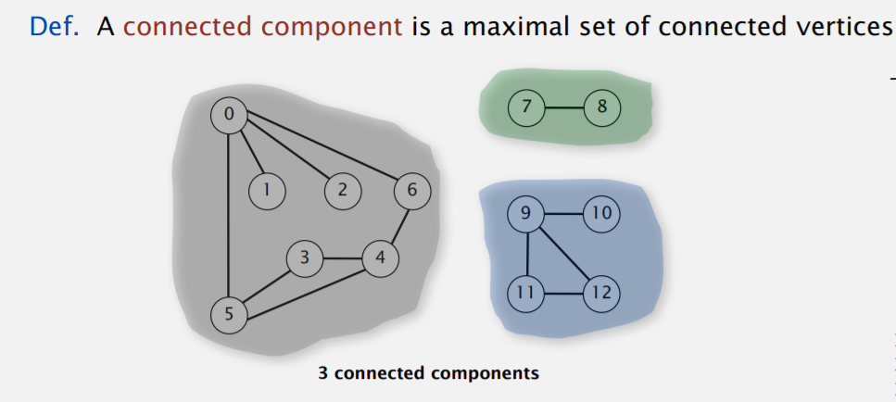
Connectivity
Connectivity queries
Given two vertices are connected ? Process to answer in constant time.

Slide 8
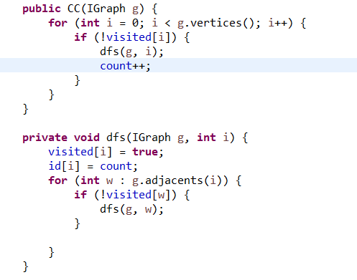
Connected Components
Mark all nodes as not visited.
For each unmarked node, run dfs to identify all vertices of same cc group

Slide 9
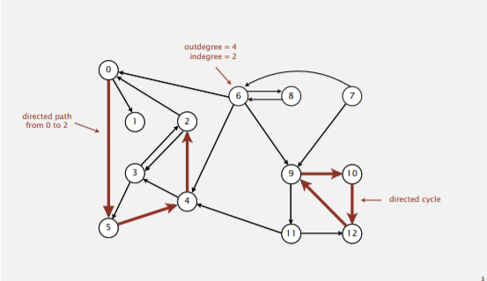
Directed Graph
Direction to node-node

